Slide 1
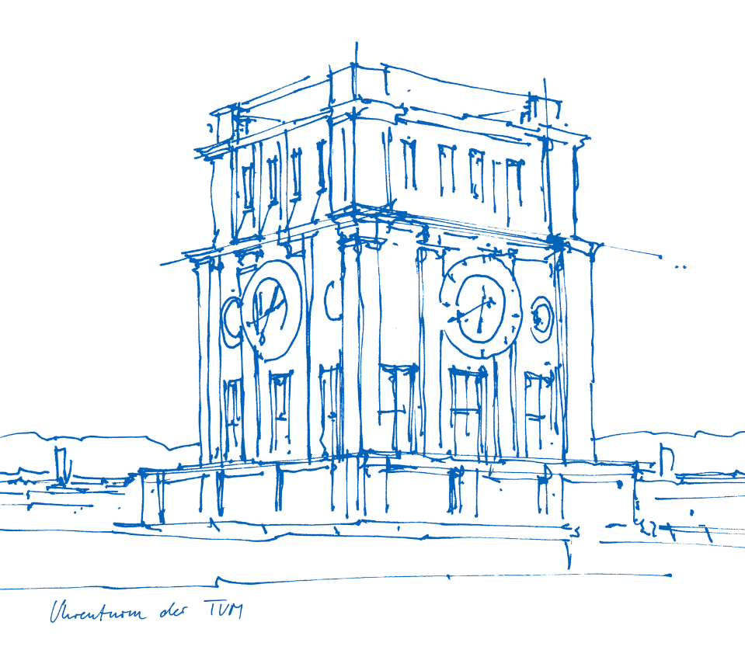
DORIS-Based Ionospheric Correction for Single-Frequency Radar Altimetry
Presenter: Ke Zhang
Supervisor: Michael Schmidt
Denise Dettmering
DORIS-Based Ionospheric Correction for Single-Frequency Radar Altimetry| Master Thesis | TUM
Notes:
Good afternoon! I am Ke Zhang, conducting research on DORIS-Based Ionospheric Correction for Single-Frequency Radar Altimetry under the supervision of Professor Michael Schmidt and Denise Dettmering.

Slide 2
DORIS-based Ionospheric Corrections
Content
Satellite Altimetry
Methods: DORIS Corrections
Results and Analysis
Outlooks
DORIS-Based Ionospheric Correction for Single-Frequency Radar Altimetry| Master Thesis | TUM
Notes:
The title mentions two satellite communication technologies: DORIS and altimetry. In my presentation, I will start by introducing these two concepts and explain why DORIS ionospheric correction is necessary for radar altimetry. Following that, I will describe the methods used to obtain DORIS ionospheric correction, present the results, and conclude with an outlook.

Slide 3
DORIS-based Ionospheric Corrections
Satellite Altimetry
DORIS-Based Ionospheric Correction for Single-Frequency Radar Altimetry| Master Thesis | TUM
Notes:
In the next section, we will address what is satellite altimetry and why altimetry requires such corrections.

Slide 4
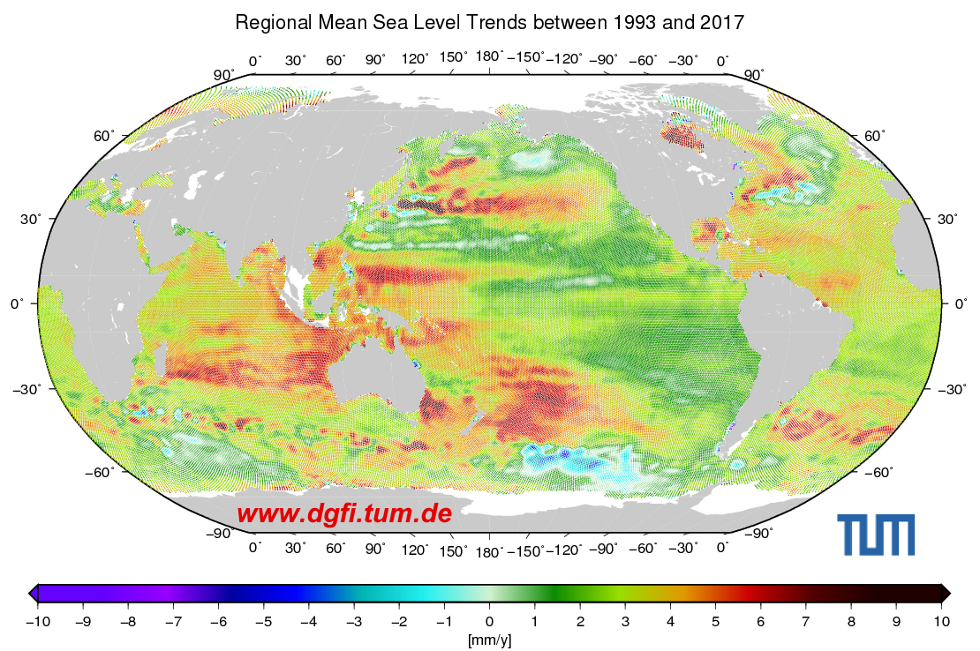
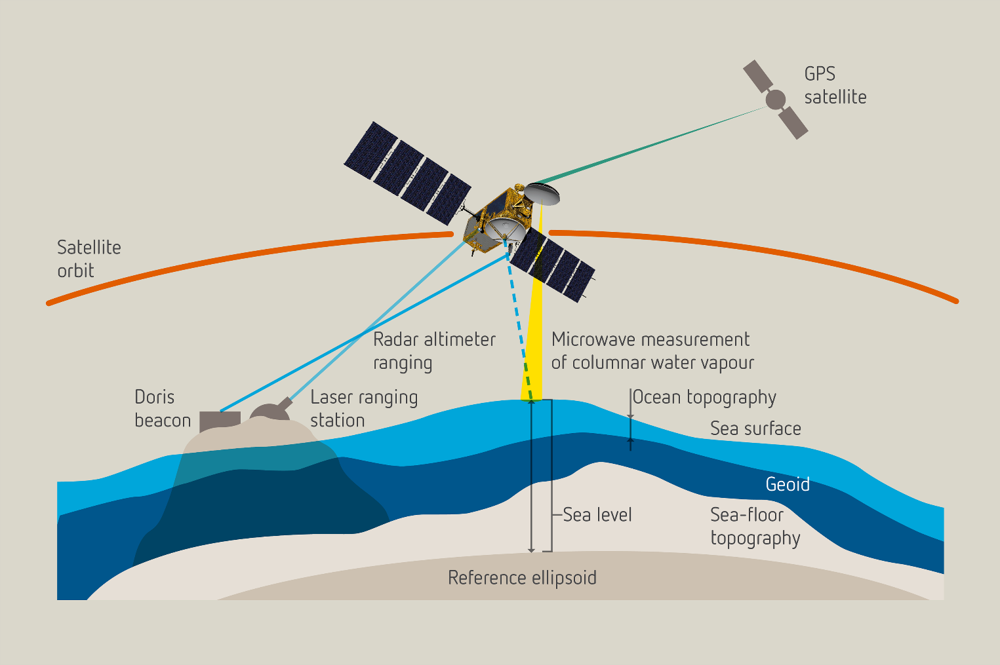
Satellite Altimetry
Monitor of ground surface elevation, especially oceanic regions
Signal sent in nadir direction, signal travel time indicates the distance
High accuracy level of orbit height and travel time measurements
DORIS-Based Ionospheric Correction for Single-Frequency Radar Altimetry| Master Thesis | TUM
Notes:
Satellite altimetry is a remote sensing technique used to monitor ground surface elevation. The figure below illustrates its operating principle. Roughly speaking, the altimetry module onboard the satellite emits signals in the nadir direction, which are reflected back by the Earth's surface (especially over oceans). By measuring the signal travel time, the height difference between the satellite and the ground can be determined.
While the principle is straightforward, achieving high-precision elevation measurements requires accurate knowledge of both the satellite's position and the altimetry observations. To ensure this accuracy, the system incorporates three modules for Precise Orbit Determination (POD), as shown in the diagram. Among these, DORIS is widely equipped on altimetry satellites.
From the regional MSL (Global Mean Sea Level) graph, we can see that altimetry places stringent demands on accuracy, as the annual variation is in milimeterlevel.

Slide 5
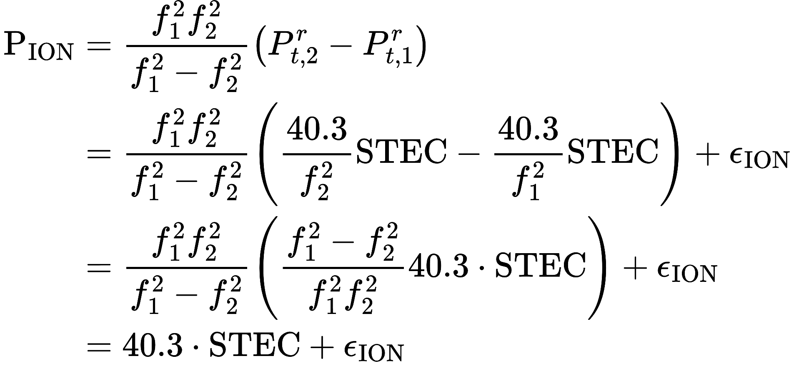
Satellite Altimetry: Observation Equation
Ionosphere combination for dual-frequency radar altimetry
How to obtain STEC (VTEC) for single-frequency radar altimetry?
DORIS-Based Ionospheric Correction for Single-Frequency Radar Altimetry| Master Thesis | TUM

Slide 6
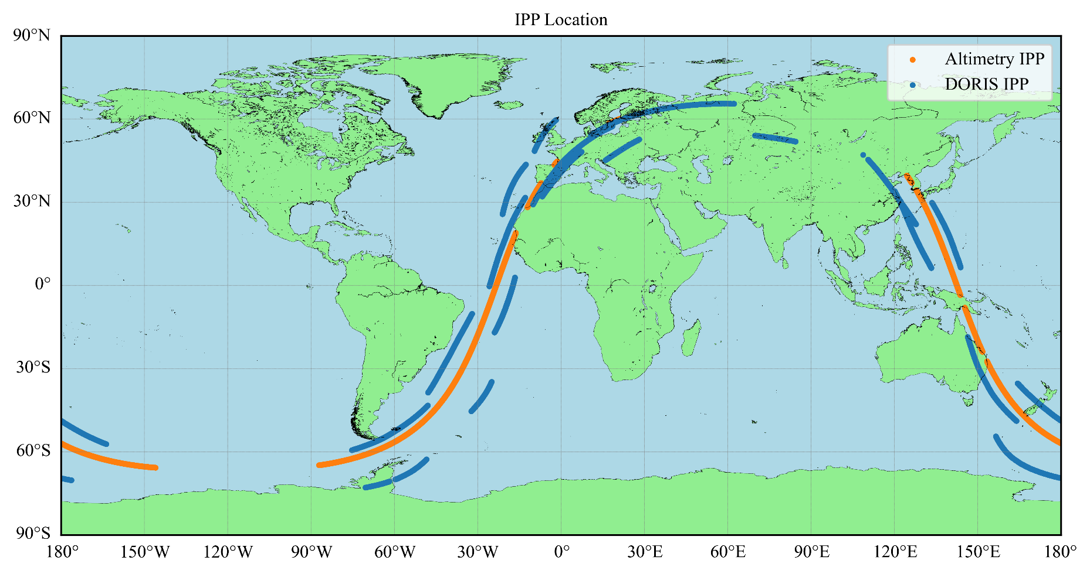
Satellite Altimetry: Jason-3 Mission
DORIS IPP and altimetry IPP are closely distributed
Dual frequency altimetry with dual frequency DORIS onboard
DORIS-based altimetry VTEC VS Dual frequency altimetry VTEC
DORIS-Based Ionospheric Correction for Single-Frequency Radar Altimetry| Master Thesis | TUM
Notes:
This figure shows the trajectories of altimetry IPP and DORIS IPP for a single revolution of the Jason-3 satellite. It can be observed that the blue curve (DORIS IPP) and the orange curve (altimetry IPP) are closly distrbuted.
Using DORIS VTEC to compute the ionospheric correction at the altimetry IPP—referred to as DORIS-based altimetry VTEC—should effectively reflect the ionospheric conditions at the altimetry IPP.
Moreover, since Jason-3 is equipped with a dual-frequency altimetry module, we can obtain dual-frequency altimetry VTEC as a direct observation at the altimetry IPP. This allows for a comparison between the DORIS-based altimetry VTEC and the dual-frequency altimetry VTEC and can be used for the assessement of accuracy of DORIS-based altimetry VTEC .

Slide 7
DORIS-based Ionospheric Corrections
Methods
DORIS-Based Ionospheric Correction for Single-Frequency Radar Altimetry| Master Thesis | TUM
Notes:
Now that we have understood the focus and necessity of this thesis, the next section will introduce how to use DORIS VTEC to obtain DORIS-based altimetry VTEC.

Slide 8
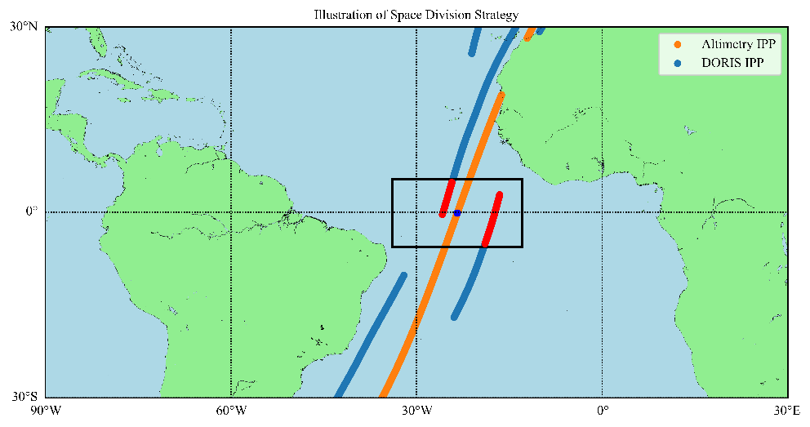
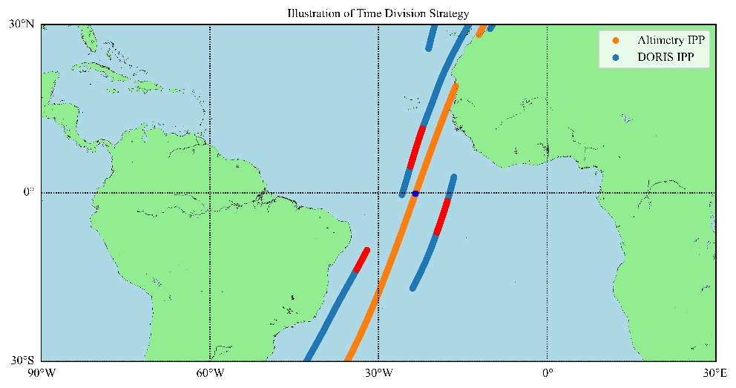
Method: DORIS-based Altimetry VTEC
DORIS VTEC
Selection
Interpolation
DORIS-based altimetry VTEC
ss55
Space Division
ss55
Time Division
DORIS-Based Ionospheric Correction for Single-Frequency Radar Altimetry| Master Thesis | TUM
Notes:
The process is as follows:
First, we need to select DORIS IPPs near the altimetry IPP—specifically, the red DORIS IPPs inside the rectangle in the figure.
Then, we perform spatial interpolation on these IPPs to obtain the DORIS-based altimetry VTEC.

Slide 9
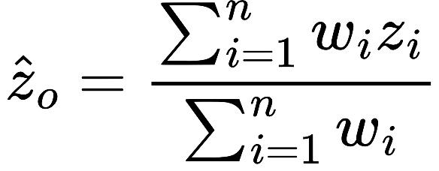
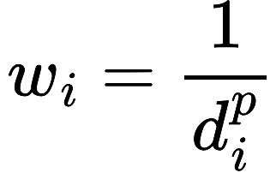
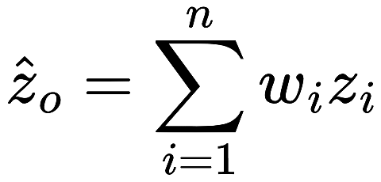
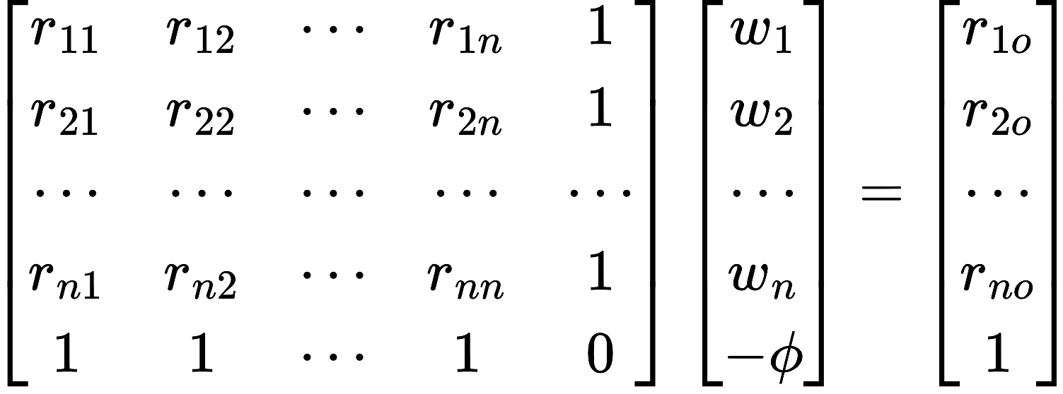
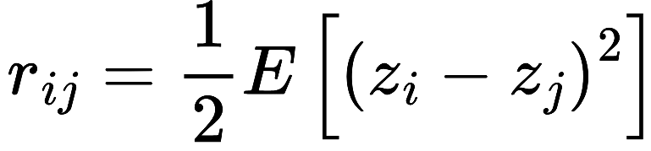
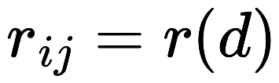
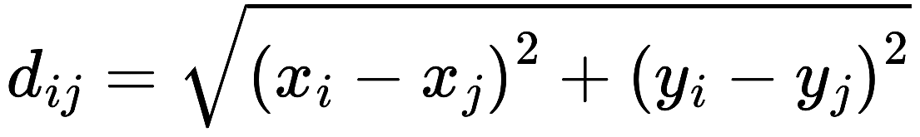
Method: Data Interpolation
DORIS VTEC
Selection
Interpolation
DORIS-base altimetry VTEC
ss55
IDW
ss55
Kriging
DORIS-Based Ionospheric Correction for Single-Frequency Radar Altimetry| Master Thesis | TUM

Slide 10
DORIS-based Ionospheric Corrections
Results and Analysis
DORIS-Based Ionospheric Correction for Single-Frequency Radar Altimetry| Master Thesis | TUM
Notes:
In the next section, we will analyze and compare the methods and parameters just introduced. The results generated with the optimal parameters will also be compared with those obtained from the GIM model.

Slide 11
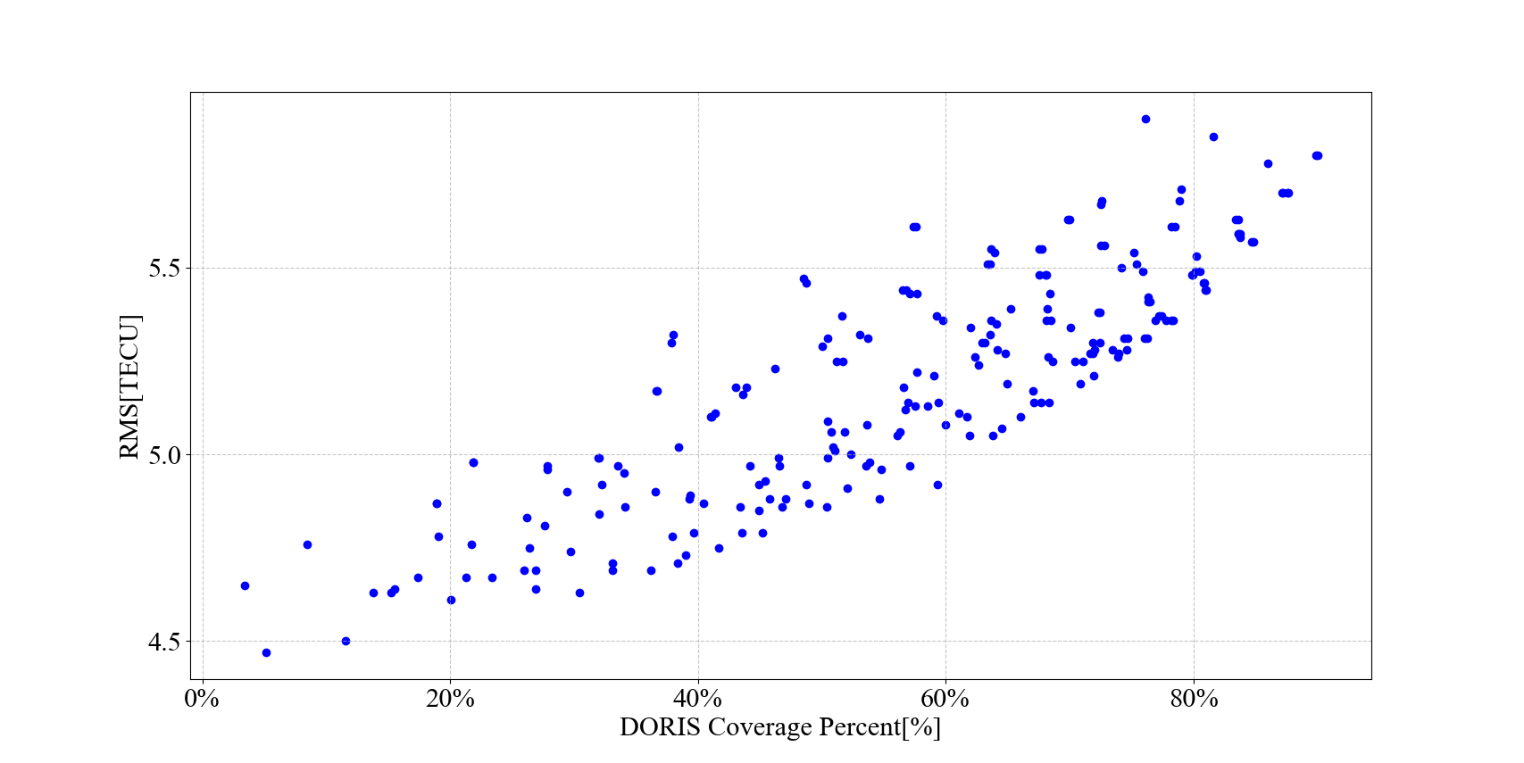
Results and Analysis
DORI-based altimetry VTEC: Comparison of parameters
Evaluation criteria: Data coverage VS Accuracy
Coverage: percentage of altimetry IPP where DORIS provides correction
Accuracy: RMS of difference between DORIS-based altimetry VTEC and Dual-frequency altimetry VTEC
DORIS-Based Ionospheric Correction for Single-Frequency Radar Altimetry| Master Thesis | TUM
Notes:
First, I will introduce the criteria for parameter comparison and the dataset used. Here:
Accuracy is measured as the RMS of the difference between DORIS-based altimetry VTEC and dual-frequency altimetry VTEC.
Data coverage is defined as the percentage of altimetry IPP locations for which ionospheric correction can be derived using DORIS data.
The figure illustrates the relationship between coverage and accuracy for various parameter sets on DOY 221 in 2023. In the right-hand curve, as accuracy improves, data coverage decreases. In contrast, on the left-hand curve, overly strict data selection criteria fail to improve accuracy. Naturally, extremely low coverage diminishes the practical utility of the method.
The figure shows that comparing accuracy alone without considering data coverage is insufficient. Therefore, in this thesis, a baseline of 50% data coverage is set for comparison. All parameter combinations listed later are evaluated with this uniform 50% data coverage as the benchmark.

Slide 12
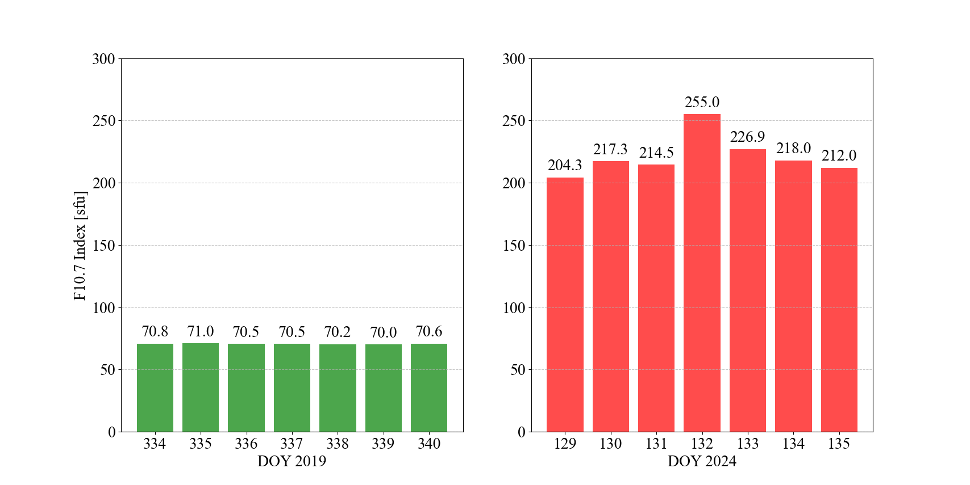
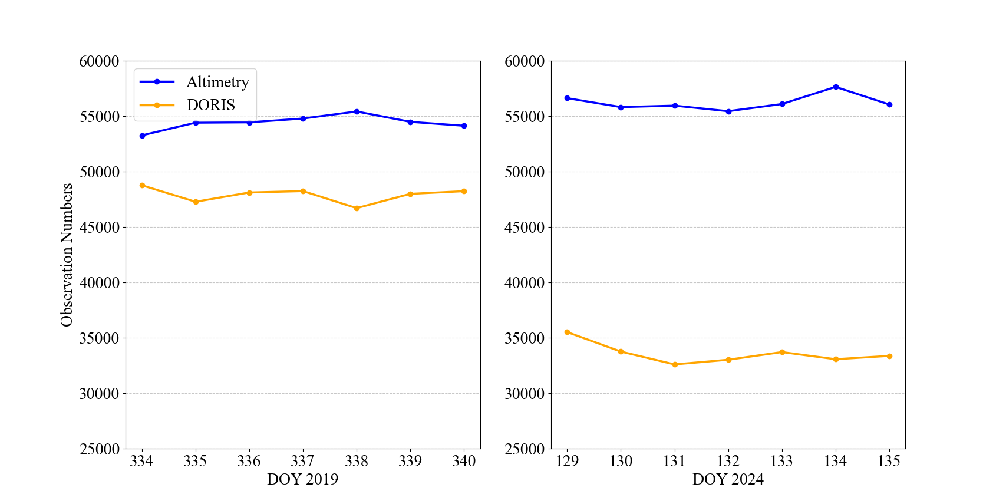
Results and Analysis
DORI-based altimetry VTEC: Comparison of parameters
Evaluation dataset: Quiet VS Active, over a week
DORIS-Based Ionospheric Correction for Single-Frequency Radar Altimetry| Master Thesis | TUM
Notes:
The first figure illustrates the ionospheric activity during two comparison periods:
On the left, the ionosphere is calm and stable over 7 days in late 2019.
On the right, the ionosphere is highly active over 7 days in May 2024, with geomagnetic storms occurring on DOY 131 and 132.
The second figure shows the number of altimetry and DORIS VTEC observations during these periods:
The altimetry count refers to the number of dual-frequency altimetry VTEC observations at altimetry IPPs.
The DORIS count refers to the number of DORIS VTEC observations at DORIS IPPs.
Altimetry observations remain relatively stable across the two periods. However, for DORIS, there is a significant decrease in observation counts during the active ionospheric period, with approximately 12,000 fewer observations. This reduction is partly due to cycle slip detection and partly due to the loss of signals at one frequency during active ionospheric conditions, which is more frequent compared to the quiet period.

Slide 13
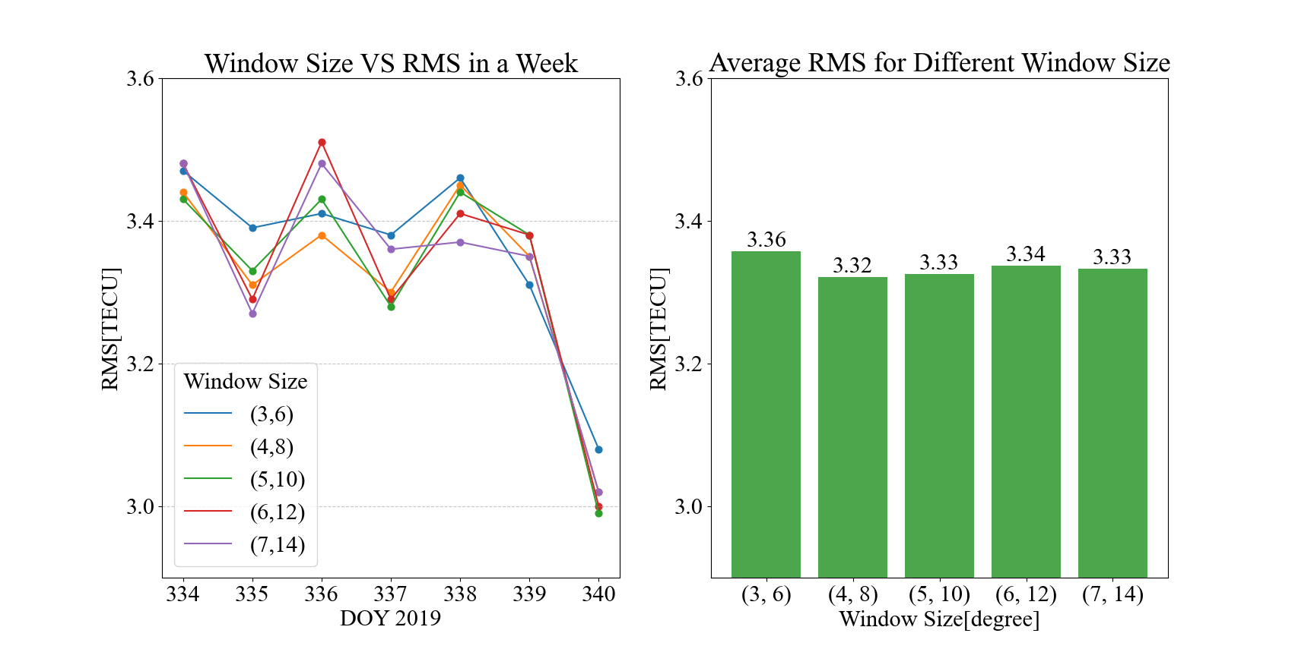
Results and Analysis
DORI-based altimetry VTEC: Data selection
Space division in quiet condition
DORIS-Based Ionospheric Correction for Single-Frequency Radar Altimetry| Master Thesis | TUM
Notes:
Now we move into the detailed data analysis.
The first figure shows how data coverage varies under different minimum observation numbers and window sizes. The yellow region represents parameter combinations where data coverage exceeds 50%.
As previously mentioned, this study uses 50% coverage as the baseline for comparison. Based on this criterion, the following parameter combinations were selected, resulting in the accuracy variation curve shown in the second figure.
From the figure, it can be observed that during the 7 days of calm ionospheric conditions, there is little difference in accuracy across different window sizes. This holds true for both the daily variations on the left and the weekly average values on the right.

Slide 14
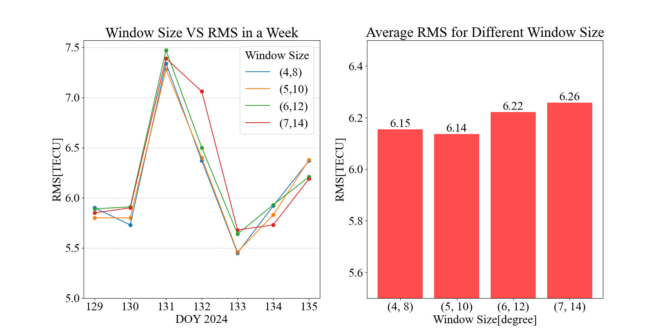
Results and Analysis
DORI-based altimetry VTEC: Data selection
Space division in active condition
DORIS-Based Ionospheric Correction for Single-Frequency Radar Altimetry| Master Thesis | TUM
Notes:
Under active ionospheric conditions, the situation differs significantly:
Limited window sizes: Only four window sizes are included in the comparison. Smaller window sizes could not achieve the 50% coverage threshold.
Daily variations (left): Due to the geomagnetic storm on DOY 131 and 132, the RMS values are significantly higher on these two days.
Weekly averages (right): As the window size increases, the RMS values gradually rise. This indicates that during periods of active ionospheric conditions, broader data selection is detrimental to improving accuracy.

Slide 15
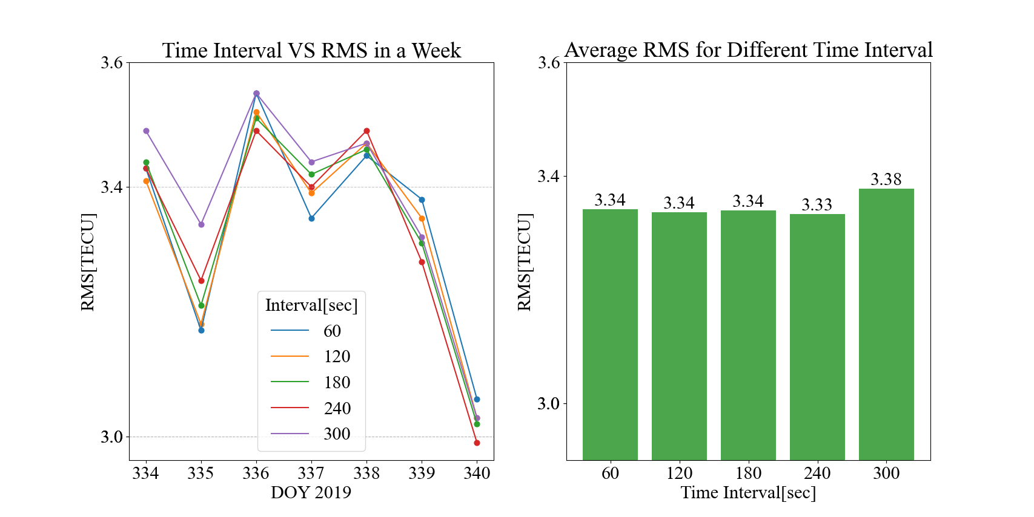
Results and Analysis
DORI-based altimetry VTEC: Data selection
Time division in quiet condition
DORIS-Based Ionospheric Correction for Single-Frequency Radar Altimetry| Master Thesis | TUM
Notes:
A similar phenomenon occurs with time division. The five time intervals chosen here span a spatial range approximately equivalent to that of the space division.
As with the spatial division, it can be observed that during quiet ionospheric conditions, different parameter sets do not lead to significant differences in accuracy.

Slide 16
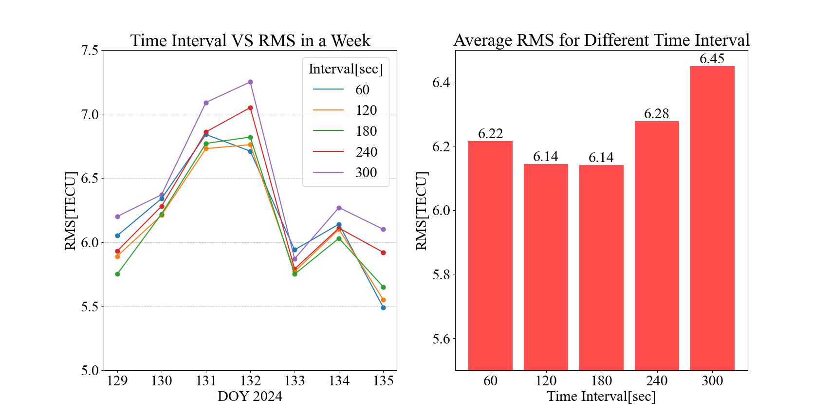
Results and Analysis
DORI-based altimetry VTEC: Data selection
Time division in active condition
DORIS-Based Ionospheric Correction for Single-Frequency Radar Altimetry| Master Thesis | TUM
Notes:
Under active ionospheric conditions, a similar trend is observed. On DOY 131 and 132, the RMS values are higher due to the geomagnetic storms. Additionally, a particularly long time interval results in a noticeable accuracy decrease.

Slide 17
Results and Analysis
DORI-based altimetry VTEC: Data selection
Comparison between two division strategies
 | Quiet | Active
Space Division[TECU] | 3.32 | 6.06
Time Division[TECU] | 3.33 | 6.14
Small difference for quiet condition, slightly larger for active
Similar processing time for both methods ( ~ 30 sec per day)
Space division will be applied for the later comparison
DORIS-Based Ionospheric Correction for Single-Frequency Radar Altimetry| Master Thesis | TUM
Notes:
When comparing the two division strategies, we did not observe significant differences in accuracy, especially during the calm 7 days . The comparisons were made using the highest accuracy values from the previous four figures..
Processing data for one day takes approximately 30 seconds for both strategies.
Since space division has a slight accuracy advantage during the active ionospheric conditions, it will be used as the selection strategy for the subsequent comparisons.

Slide 18
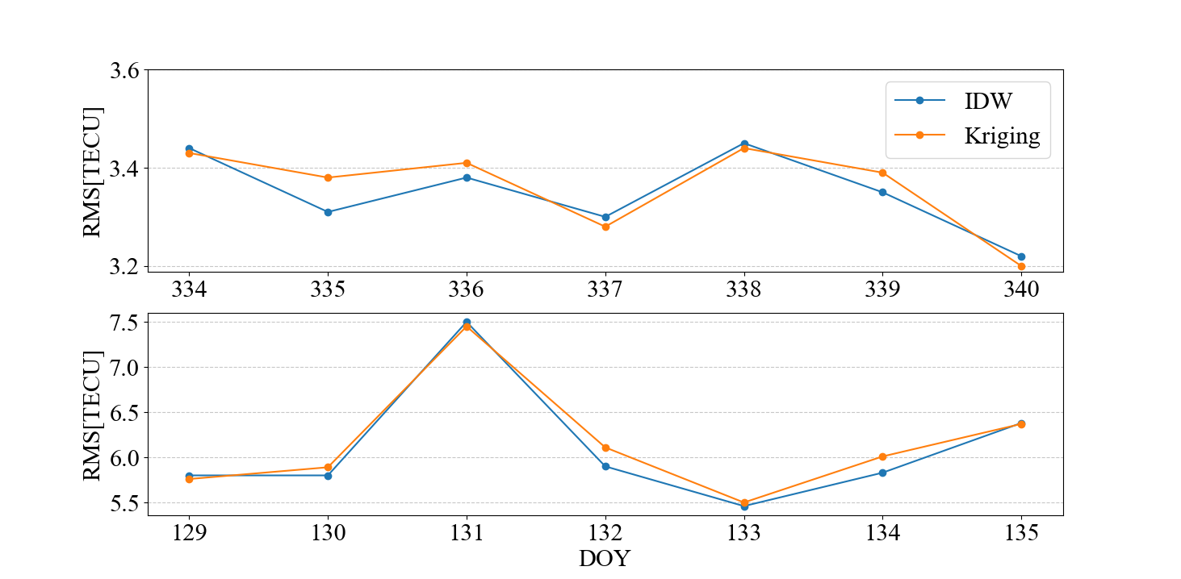
Results and Analysis
DORI-based altimetry VTEC: Data interpolation
IDW VS Kriging
No significant difference in interpolation methods
Much heavier computational load for Kriging (6x processing time)
DORIS-Based Ionospheric Correction for Single-Frequency Radar Altimetry| Master Thesis | TUM

Slide 19
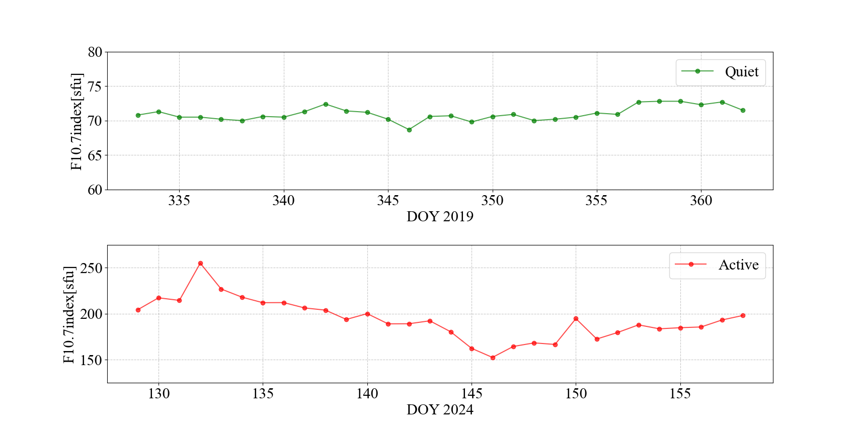
Results and Analysis
DORI-based altimetry VTEC: Comparison with GIM
Evaluation dataset: Quiet VS Active, over 30 days
DORIS-Based Ionospheric Correction for Single-Frequency Radar Altimetry| Master Thesis | TUM
Notes:
Here, we used two periods of data, each lasting 30 days, covering both quiet and active ionospheric conditions.

Slide 20
Results and Analysis
DORI-based altimetry VTEC: Comparison with GIM
DORIS VTEC
near altimetry IPP
DORIS VTEC
near altimetry IPP
DORIS VTEC
near altimetry IPP
DORIS-based altimetry VTEC
GIM-based altimetry VTEC
GIM-interpolated altimetry VTEC
DORIS VTEC at DORIS IPP
GIM VTEC at grid point
selection
GIM VTEC at grid point
interpolation
DORIS VTEC
near altimetry IPP
interpolation
GIM VTEC
near altimetry IPP
GIM VTEC at altimetry IPP
Interpolation
interpolation
DORIS VTEC at altimetry IPP
GIM VTEC at altimetry IPP
DORIS-Based Ionospheric Correction for Single-Frequency Radar Altimetry| Master Thesis | TUM
Notes:
There are three sets of data used for comparison:
DORIS-based altimetry VTEC, which we discussed earlier, selection and interpolation
GIM-based altimetry VTEC, obtained by directly interpolating GIM data at altimetry I PPs.
GIM-interpolated altimetry VTEC, where, after DORIS data selection, GIM is interpolated at the selected DORIS IPPs, followed by a second interpolation using IDW to obtain VTEC at altimetry IPPs.
The inclusion of the third VTEC set ensures that it is derived using exactly the same process as DORIS-based altimetry VTEC, addressing the inconsistency in the methods used to obtain the first two VTEC products.

Slide 21
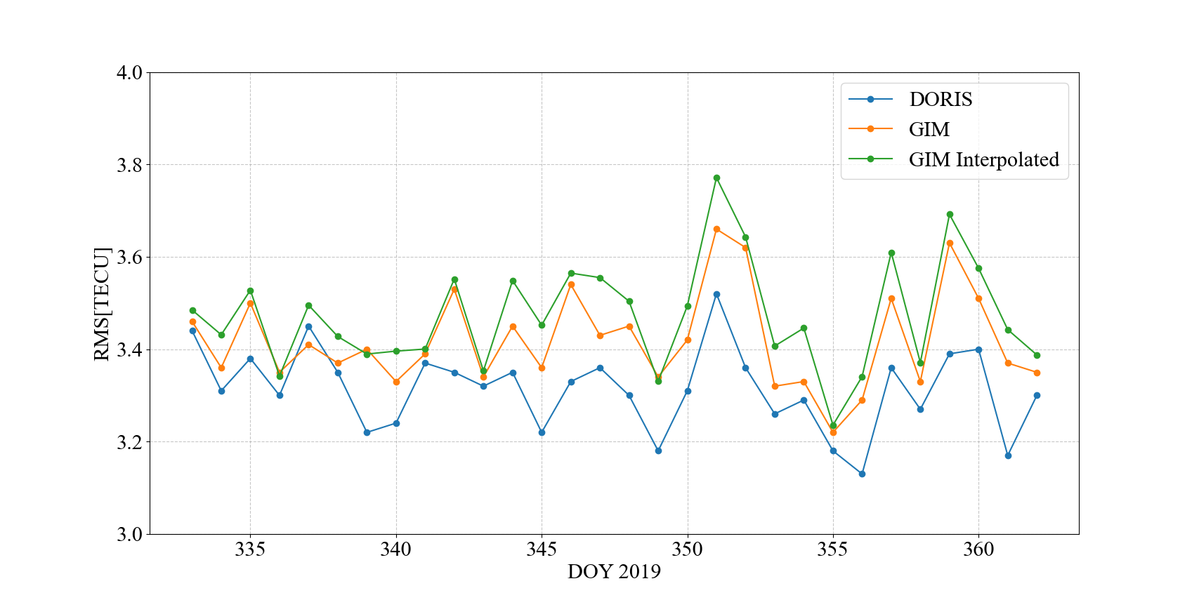
Results and Analysis
DORI-based altimetry VTEC: Comparison with GIM - Quiet
 | DORIS | GIM | GIM-int
RMS [TECU] | 3.31 | 3.42 | 3.45
DORIS-Based Ionospheric Correction for Single-Frequency Radar Altimetry| Master Thesis | TUM
Notes:
During the quiet period, the comparison of the 30-day data is shown in the figure. It can be observed that DORIS-based altimetry VTEC (blue) consistently has slightly lower RMS values on each day compared to the GIM-based altimetry VTEC (orange). This indicates that during periods of low ionospheric activity, DORIS correction produces slightly better results than GIM.
The GIM-interpolated altimetry VTEC (green) shows the worst performance, suggesting that the difference between the blue and orange curves is not due to the different interpolation strategies, but rather reflects the inherent differences in the DORIS data itself.

Slide 22
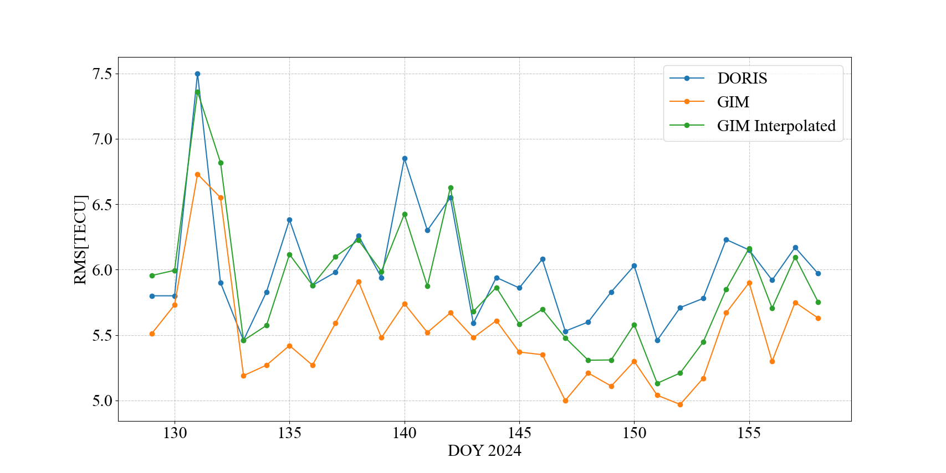
Results and Analysis
DORI-based altimetry VTEC: Comparison with GIM - Active
 | DORIS | GIM | GIM-int
RMS [TECU] | 6.01 | 5.52 | 5.88
DORIS-Based Ionospheric Correction for Single-Frequency Radar Altimetry| Master Thesis | TUM
Notes:
However, during the active period, the performance of DORIS-based altimetry VTEC is inferior to that of the GIM-based altimetry VTEC. In fact, it performs worse than the GIM-interpolated altimetry VTEC as well. This suggests that during active ionospheric conditions, DORIS correction may not be as effective, possibly due to the increased ionospheric activity affecting the quality of DORIS-based measurements.

Slide 23
Results and Analysis
DORI-based altimetry VTEC: Comparison with GIM
Accuracy comparison in quiet and active conditions
 | DORIS | GIM | GIM-int
Quiet [TECU] | 3.31 | 3.42 | 3.45
Active [TECU] | 6.01 | 5.52 | 5.88
GIM performs better than GIM-int: one more interpolation brings loss
Smaller RMS for DORIS than GIM or GIM-int in quiet condition
Not ideal accuracy for DORIS in active condition
Fewer observation numbers in active condition ( ~ 12000 per day)
Higher variation of selected DORIS VTEC
Window Size | [3,6] | [4,8] | [5,10]
Quiet STD | 0.56 | 0.74 | 0.84
Active STD | 1.46 | 1.80 | 2.09
DORIS-Based Ionospheric Correction for Single-Frequency Radar Altimetry| Master Thesis | TUM
Notes:
Here, we compare the RMS values of the three products over the two periods. GIM always performs better than GIM-interpolated VTEC, which indicates that additional interpolation, similar to DORIS, does not improve RMS values; in fact, the extra interpolation results in an accuracy loss.
The poorer performance of DORIS-based altimetry VTEC under active conditions can be attributed to two factors:
Fewer observations: There are about 12,000 fewer DORIS VTEC observations per day in active conditions. To achieve 50% data coverage, a less stringent data selection strategy is necessary.
Greater ionospheric variability: The more active ionospheric conditions cause greater fluctuation in VTEC values at different DORIS IPPs.
The table shows the standard deviation (STD) of DORIS VTEC's STEC within a window for both quiet and active conditions under the same data selection strategy. Clearly, the larger the window, the higher the STD, and under active conditions, the STD is more than twice as large as it is under quiet conditions.

Slide 24
DORIS-based Ionospheric Corrections
Outlooks
DORIS-Based Ionospheric Correction for Single-Frequency Radar Altimetry| Master Thesis | TUM
Notes:
Our presentation is divided into these seven parts.

Slide 25
Outlook
Computation of GIM VTEC through Spherical Coefficients
Reduction of the accuracy loss from GIM interpolation
Accuracy increase for both GIM and DORIS correction
Flexible Data Selection Strategy
Smaller windows for active regions, larger windows for quiet regions
A better balance between coverage and accuracy
Combination of Different VTEC Corrections
GIM+DORIS
Extended Temporal Analysis on Ionospheric Conditions
Longer analysis for the identification of specific ionospheric conditions, under which DORIS products outperform GIM products
Altimetry Corrections across Different Satellite Altitudes
Accuracy analyses for satellites operating at different altitudes:
Sentinel-3 A/B, SARAL
DORIS-Based Ionospheric Correction for Single-Frequency Radar Altimetry| Master Thesis | TUM
Notes:
Here are several potential future prospects for improving the methodology and extending this research:
Enhancing Accuracy
In the current GIM results, bilinear interpolation was used to obtain GIM VTEC at altimetry IPPs due to the limited spatial resolution of GIM products, which introduces accuracy loss. Alternatively, spherical harmonic coefficients can directly compute VTEC at specific locations, reducing this interpolation error.
Additionally, since GIM was used for leveling DORIS VTEC, leveraging GIM directly for the leveling process could minimize interpolation loss at leveled DORIS VTEC.
Adaptive Data Selection
Introducing adaptive windows for data selection could improve the balance between accuracy and coverage. For example, smaller windows can be applied to regions with high ionospheric activity, while larger, more lenient windows can be used in quieter regions.
Combining Multiple Sources
To mitigate DORIS's limitations during active ionospheric conditions, combining DORIS with other products (e.g., GIM or GNSS-based corrections) could improve the overall robustness and performance of the correction process.
Long-term and Active Period Analysis
Conducting a broader analysis of DORIS data over longer timeframes and under highly active ionospheric conditions may help identify specific ionospheric conditions, under which DORIS products outperform GIM products and vise versa.
Expanding to Other Altimetry Missions
This study focused solely on Jason-3 observations. Future work could extend the analysis to other altimetry missions, such as Sentinel-3 A/B, which operate at slightly lower orbits. These newer missions could provide additional insights and validation opportunities.

Slide 26
DORIS-based Ionospheric Corrections
Thanks for your attention!
Tree Species Classification| Data Science in Earth Observation| ESPACE Wintersemester 2023/2024 | TUM
Notes:
This is the tree species classification content, Thanks for your attention!

Slide 27
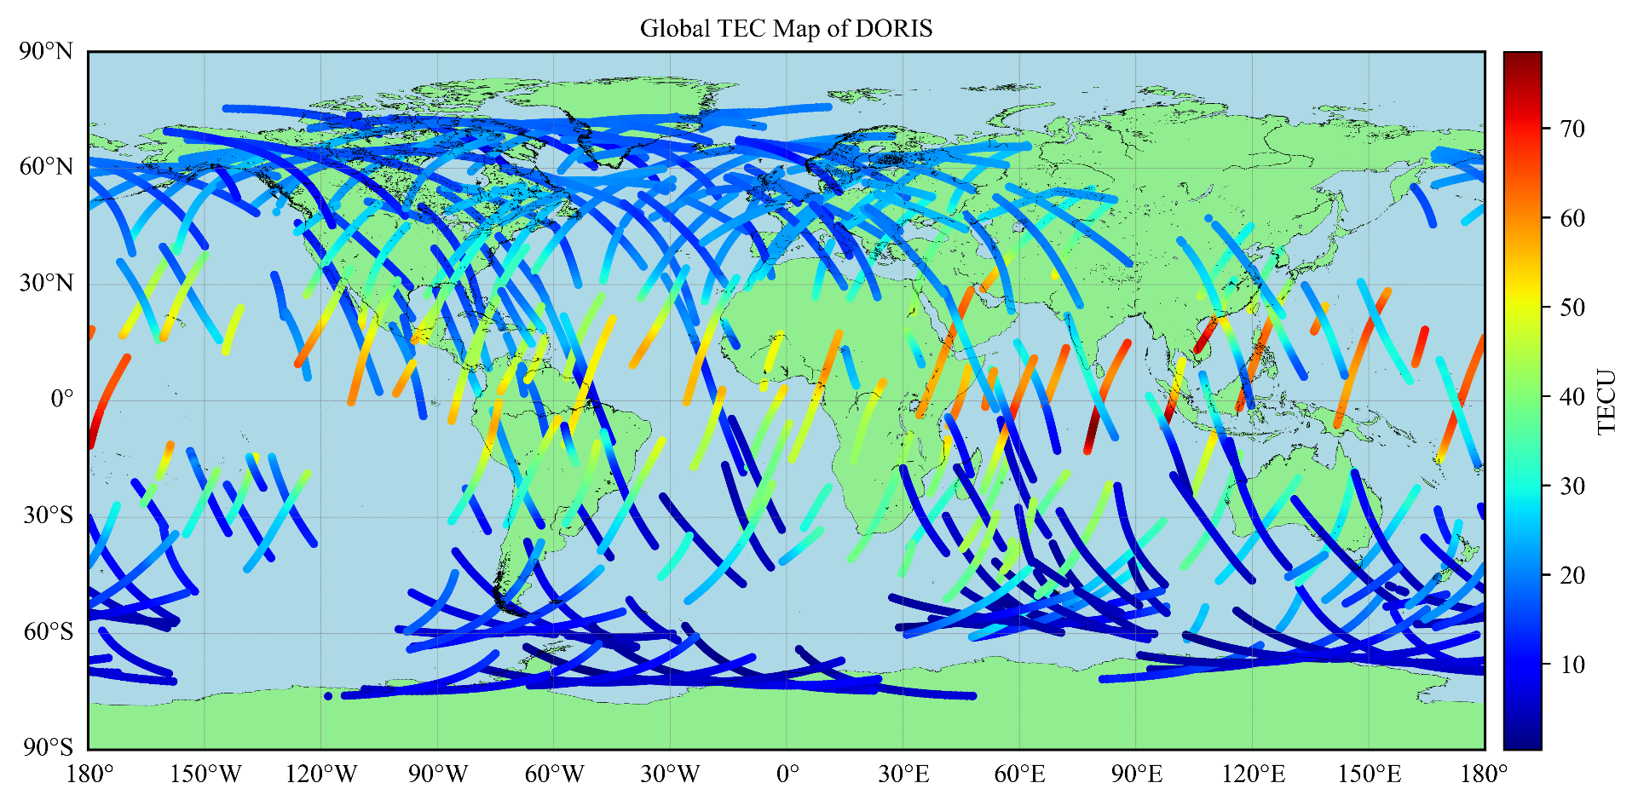
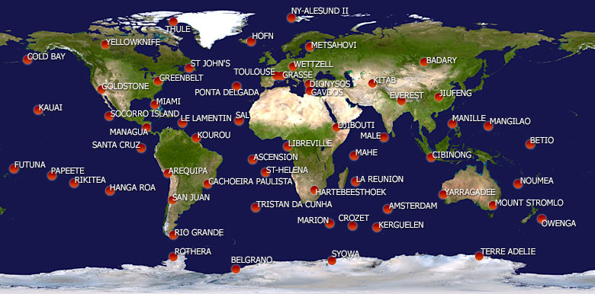
DORIS - Ground and Satellite Segments
Data transmission from ground beacon to satellite
Data reception and dissemination done by satellite
Worldwide distribution of ground stations, including oceanic regions
DGXX receivers: track up to seven signals at the same time
DORIS-Based Ionospheric Correction for Single-Frequency Radar Altimetry| Master Thesis | TUM

Slide 28
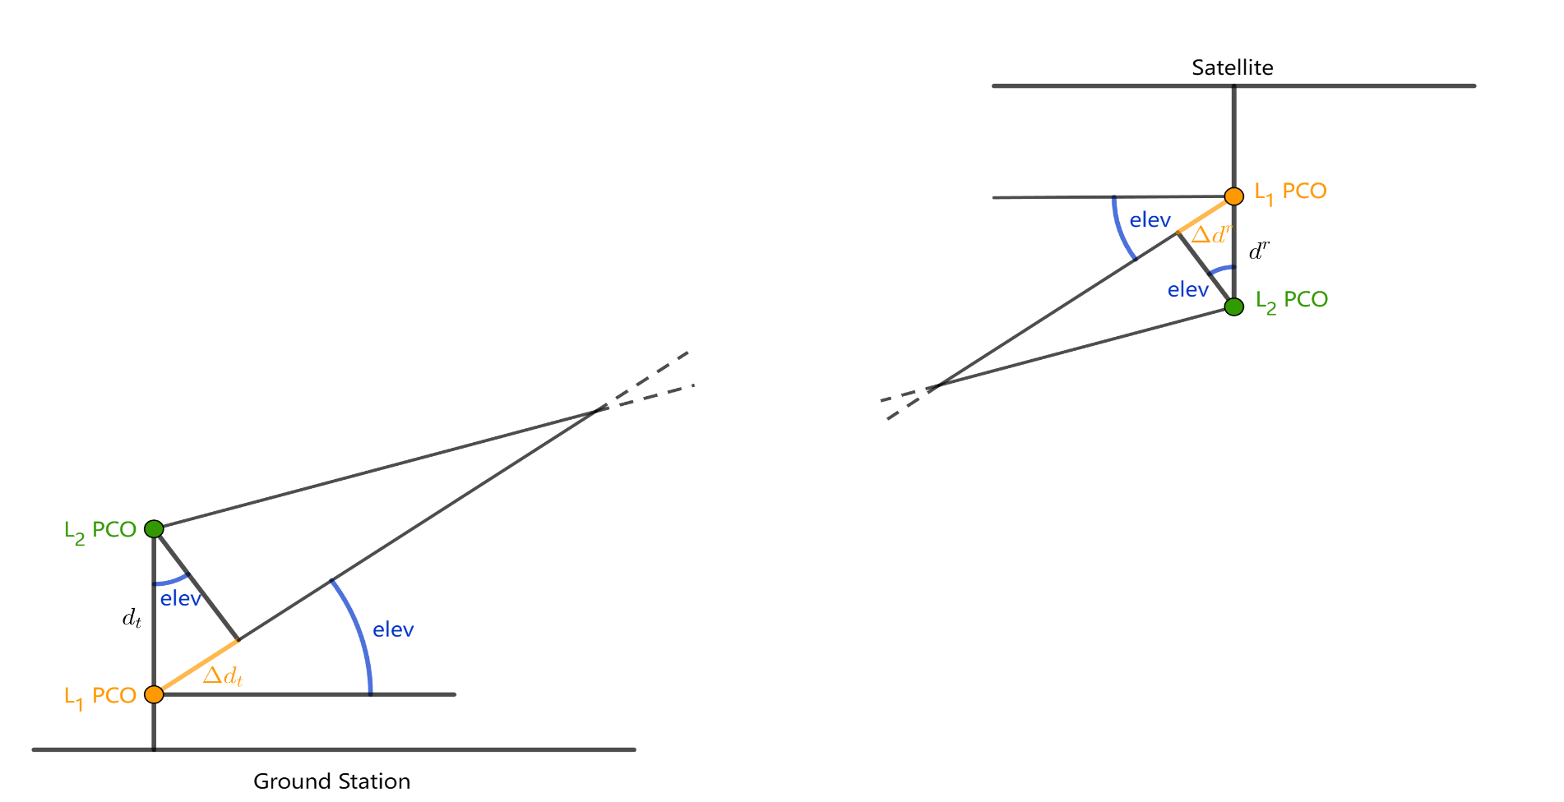
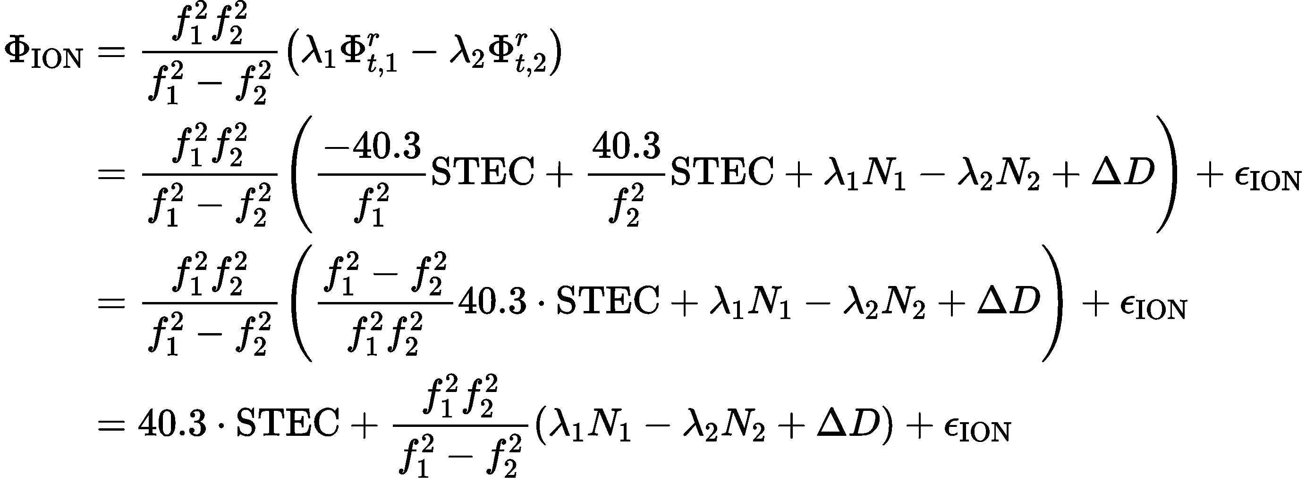
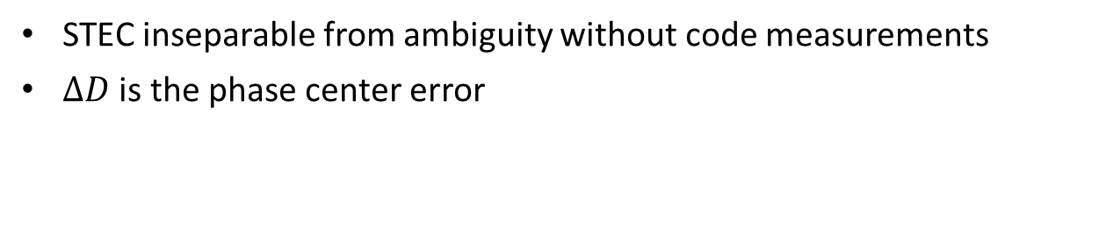
DORIS - Observation Equation
Ionosphere combination of two frequencies:
STEC inseparable from ambiguity without code measurements
$ΔD$ is the phase center error
Satellite | Offset [m] | Beacon | Offset [m]
Jason-2 | 0.164 | Alcatel | 0.175
Jason-3 | 0.168 | STAREC | 0.487
DORIS-Based Ionospheric Correction for Single-Frequency Radar Altimetry| Master Thesis | TUM

Slide 29
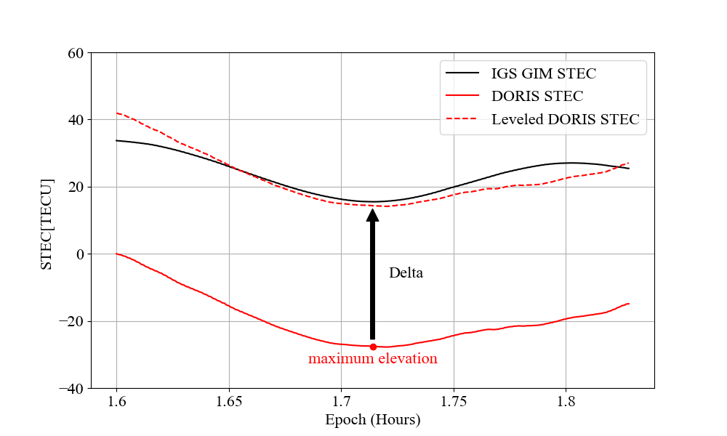
DORIS – STEC Leveling: Per-pass Basis
GIM STEC
Unleveled DORIS STEC
DORIS STEC
Pass detection: filter of outliers or interrupted observations
GIM VTEC interpolation: GIM VTEC at DORIS IPP and epoch
Height scaling: different orbit heights of GNSS and LEO satellite
Mapping function: GIM VTEC to GIM STEC
Mission | Orbit Height [km] | Scaling Factor
Jason-3 | 1350 | 0.925
HY-2A | 970 | 0.880
SARAL | 800 | 0.856
DORIS-Based Ionospheric Correction for Single-Frequency Radar Altimetry| Master Thesis | TUM

Slide 30
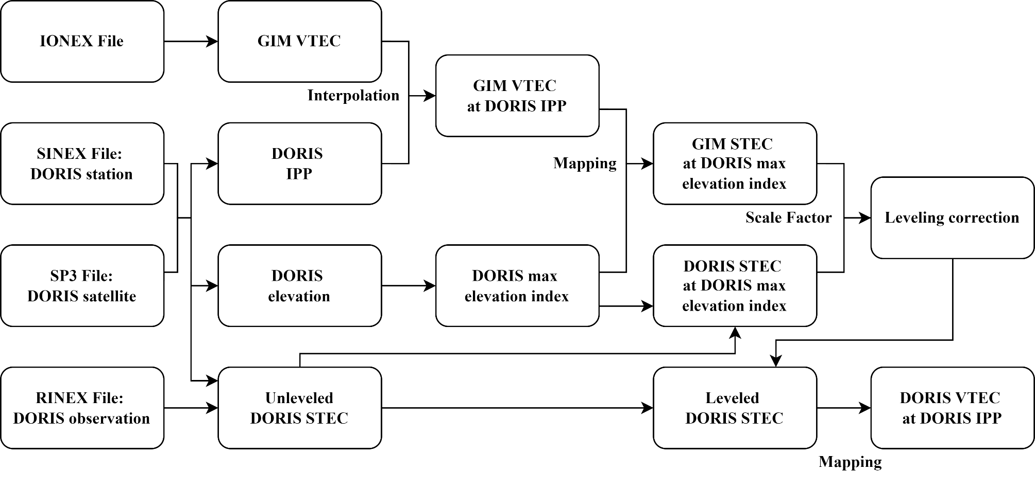
DORIS – STEC Leveling: Per-pass Basis
Computation flow from unleveled DORIS STEC to leveled DORIS VTEC
DORIS-Based Ionospheric Correction for Single-Frequency Radar Altimetry| Master Thesis | TUM

Slide 31
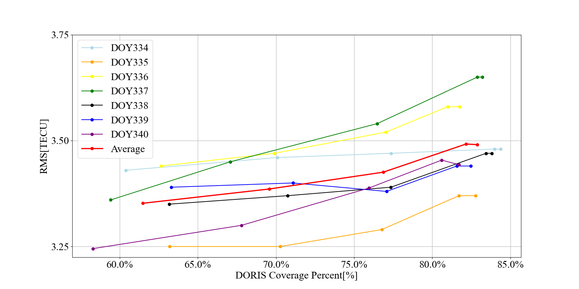
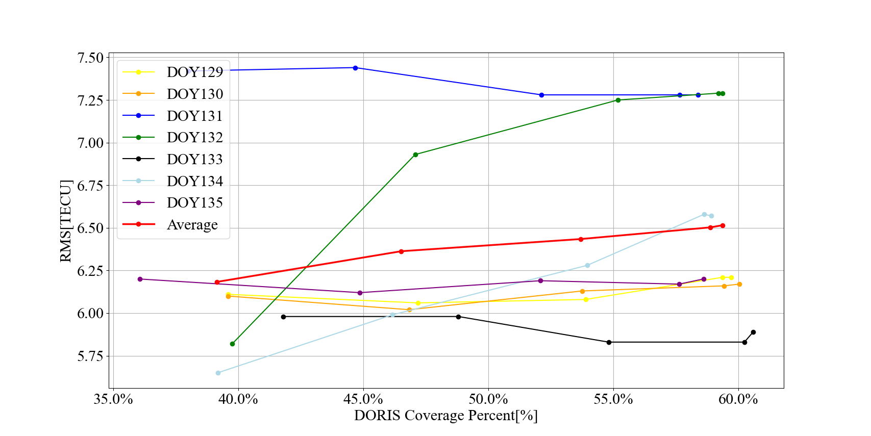
Results and Analysis
DORI-based altimetry VTEC: Elevation mask
Elevation: 0, 5, 10, 15, 20 degrees
DOY 2019 (quiet)
DOY 2024 (active)
DORIS-Based Ionospheric Correction for Single-Frequency Radar Altimetry| Master Thesis | TUM

Slide 32
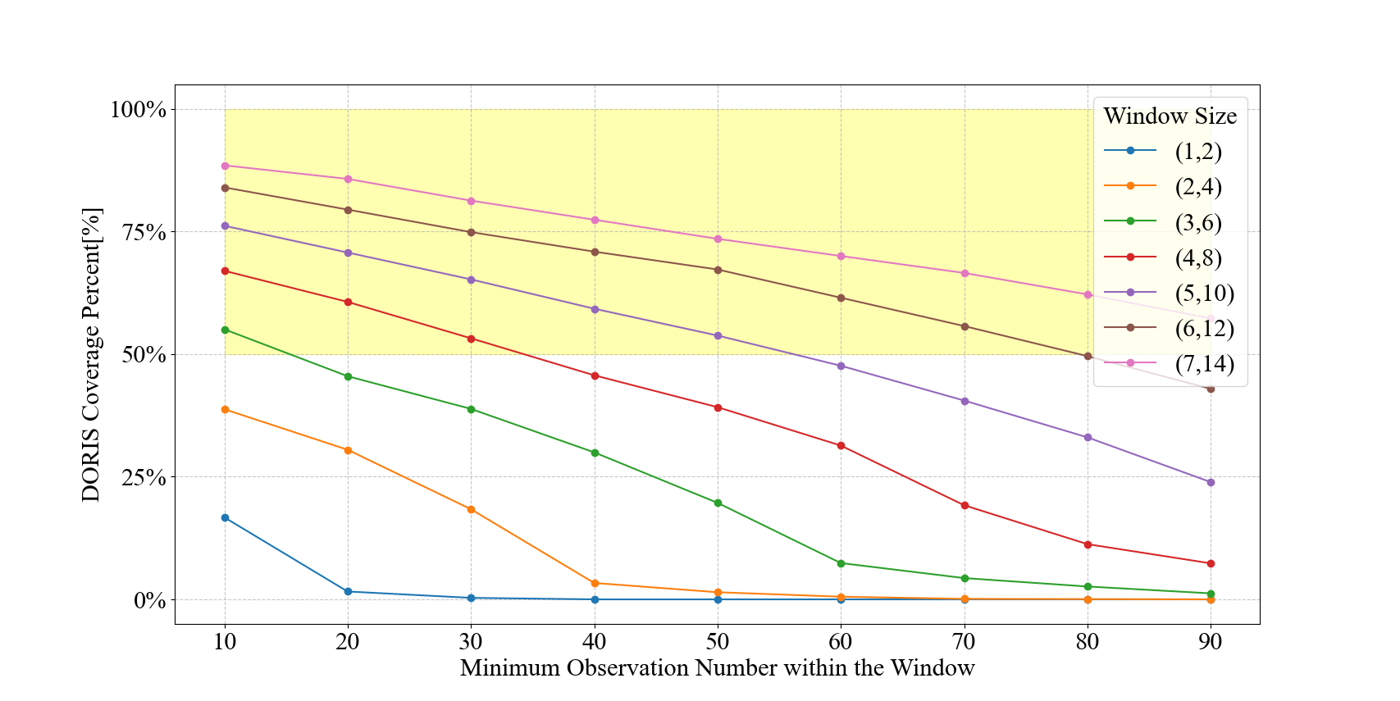
Results and Analysis
DORI-based altimetry VTEC: Data selection
Spatial division: Window size and min obs number within
Window | (3,6) | (4,8) | (5,10) | (6,12) | (7,14)
Min Obs | 10 | 30 | 50 | 70 | 90
DORIS-Based Ionospheric Correction for Single-Frequency Radar Altimetry| Master Thesis | TUM

Slide 33
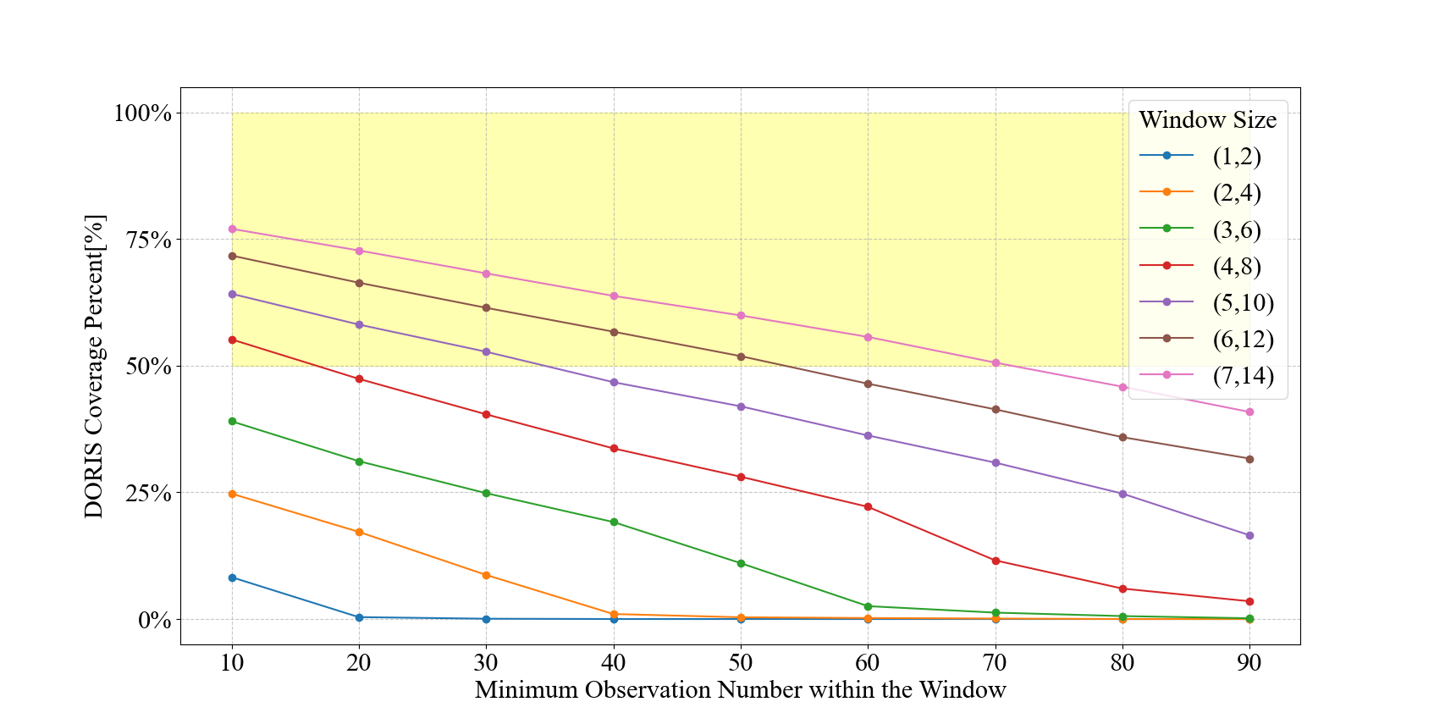
Results and Analysis
DORI-based altimetry VTEC: Data selection
Spatial division: Window size and min obs number within
Window | (4,8) | (5,10) | (6,12) | (7,14)
Min Obs | 10 | 30 | 50 | 70
DORIS-Based Ionospheric Correction for Single-Frequency Radar Altimetry| Master Thesis | TUM

Slide 34
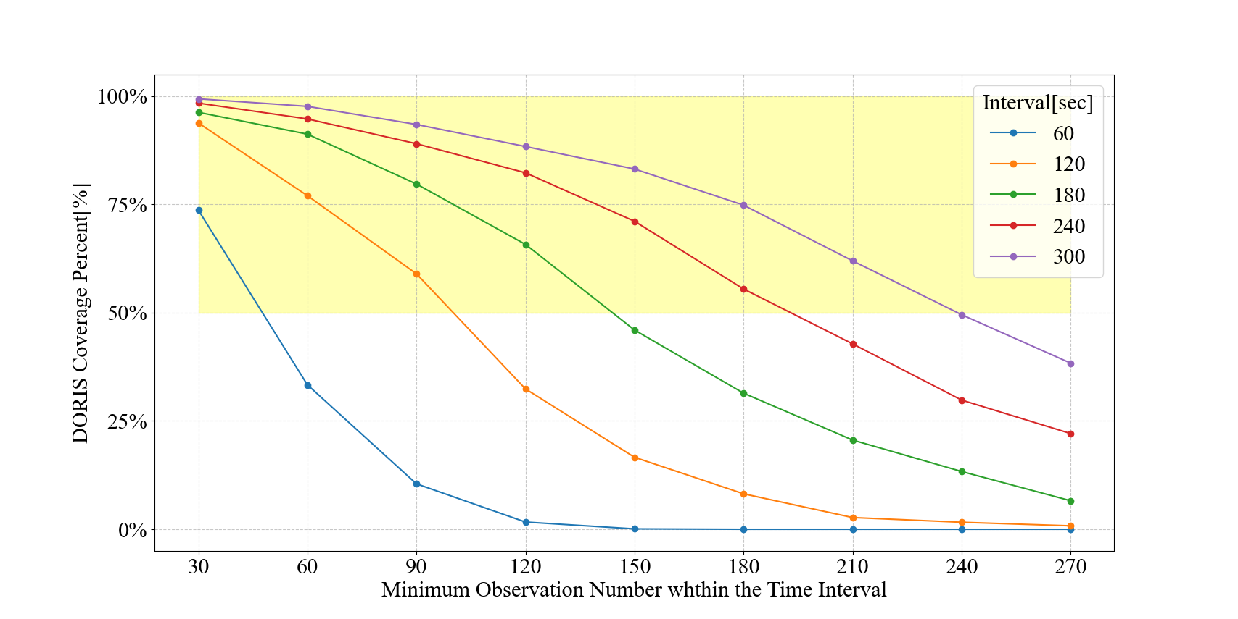

Results and Analysis
DORI-based altimetry VTEC: Data selection
Time division: Time interval and min obs number within
Interval | 60s | 120s | 180s | 240s | 300s
Min Obs | 50 | 100 | 140 | 180 | 225
DORIS-Based Ionospheric Correction for Single-Frequency Radar Altimetry| Master Thesis | TUM

Slide 35
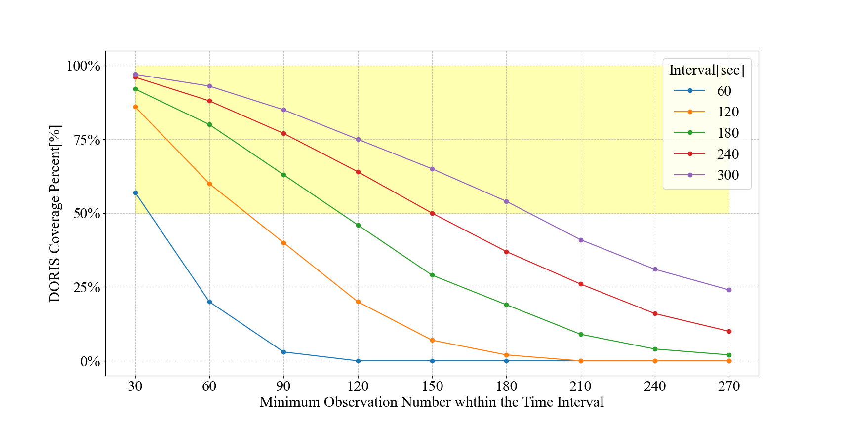

Results and Analysis
DORI-based altimetry VTEC: Data selection
Time division: Time interval and min obs number within
Interval | 60s | 120s | 180s | 240s | 300s
Min Obs | 35 | 75 | 110 | 150 | 180
DORIS-Based Ionospheric Correction for Single-Frequency Radar Altimetry| Master Thesis | TUM

